Slide 1
MODEL BUILDING PHASE
IMPACT OF AN INCIDENT PREDICTION PROJECT
BY-Amruta Kumbar

Slide 2

Business Problem
To identify the impacts of incidents raised by the Customers
Project Objective
The Objective of the problem is to predict the impact of the incidents raised by the customers based on the priority levels with respect to the corresponding incident team.
Priority level being stated as:-
Low priority level
Medium priority level
High priority level

Slide 3
Project Architecture / Project Flow

Slide 4
Exploratory Data Analysis (EDA) and
Feature Engineering

Slide 5
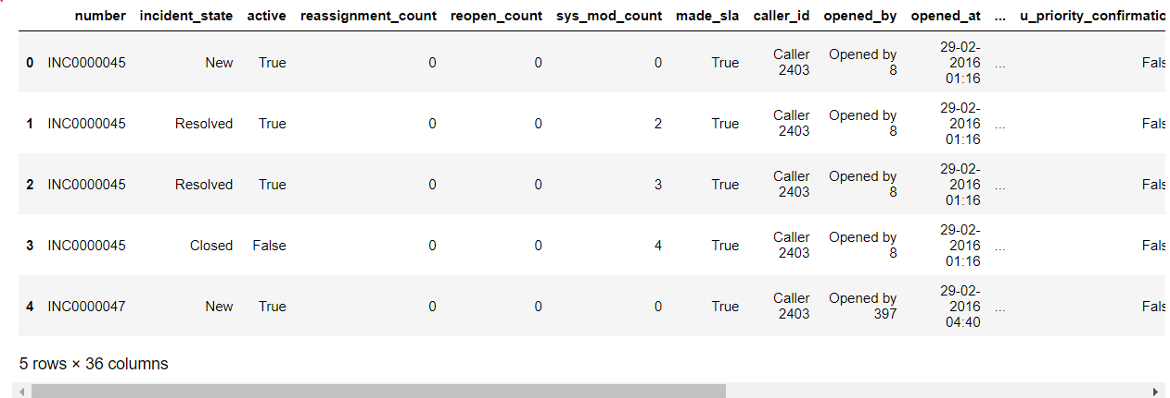
Data set details
Data set imported as csv:
Data Set Details in brief:
About the dataset | In Numbers
Shape | (141712, 36)
Dtypes | Object(29),bool(4),Int 64(3)
Missing Values | Depicted as ? In the dataset
Change of data types | Categories ,int64
Date Columns | (mm,dd,yy hh:mm:ss)

Slide 6
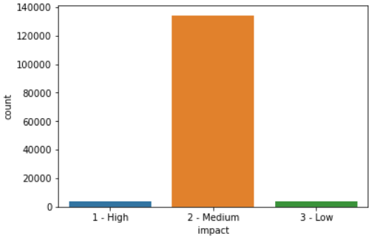
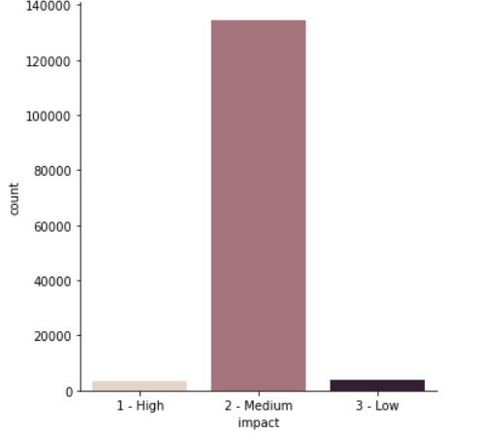
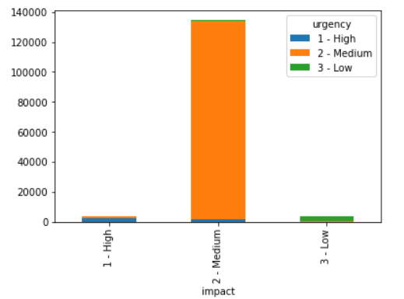
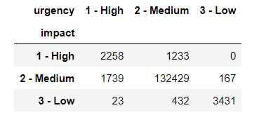
Visualization of the data set
Impact Count plot
Impact cat Plot
Stacked bar plot of the Cross tab
Crosstab : Impact and Urgency

Slide 7
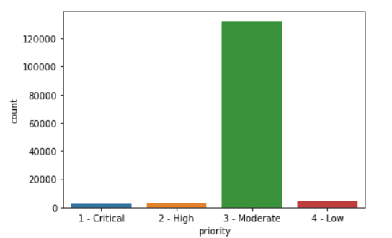
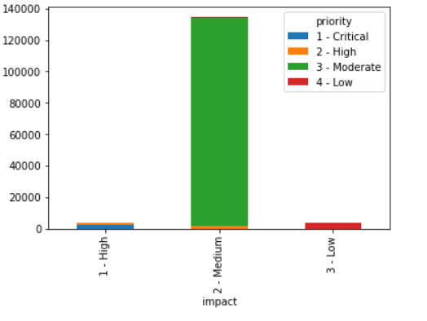
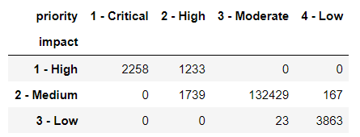
Visualization of Priority
Count plot : Priority
Stacked bar plot : priority and impact
Crosstab : priority and impact

Slide 8
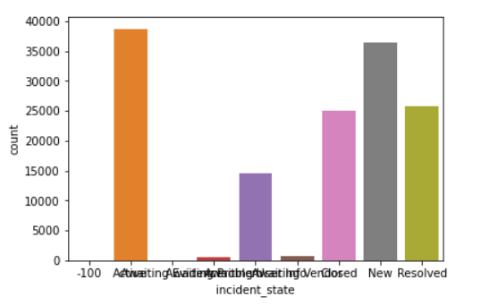
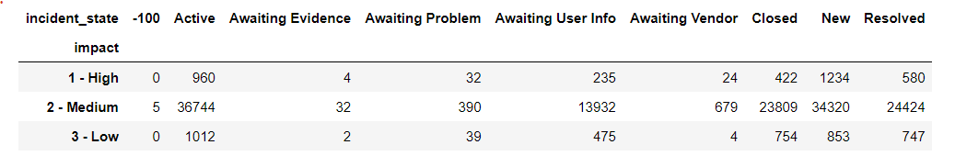
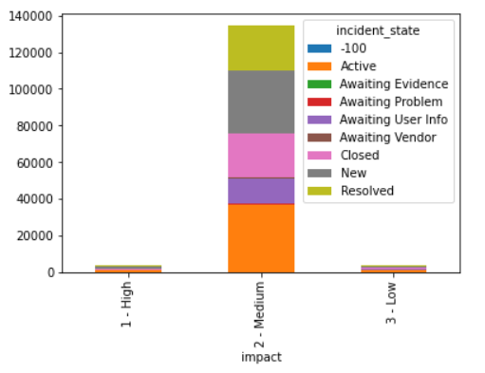
Incident state
Incident state
Crosstab :incident state and impact

Slide 9
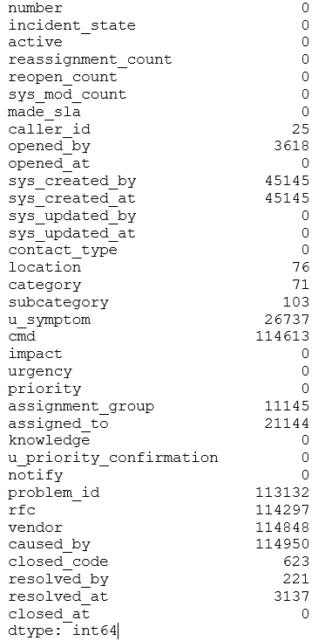
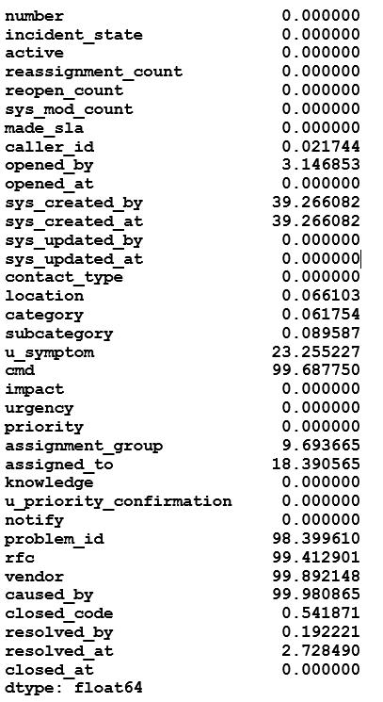
Treating Missing Values
Missing values are represented as (?) thus Replacing With NAN
Missing values for each column
Percentage of Missing values

Slide 10
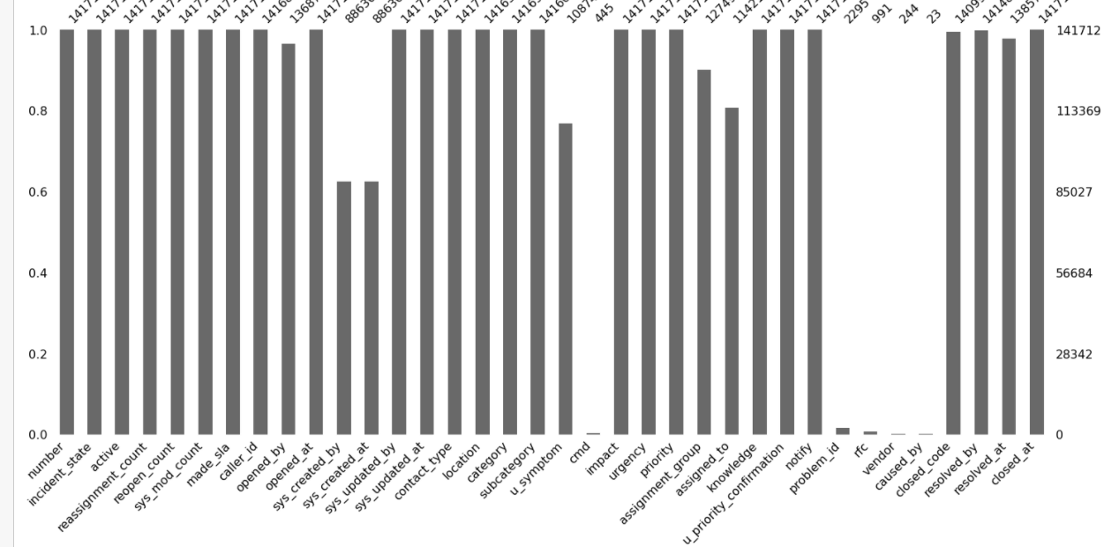
Visualization of the missing values

Slide 11
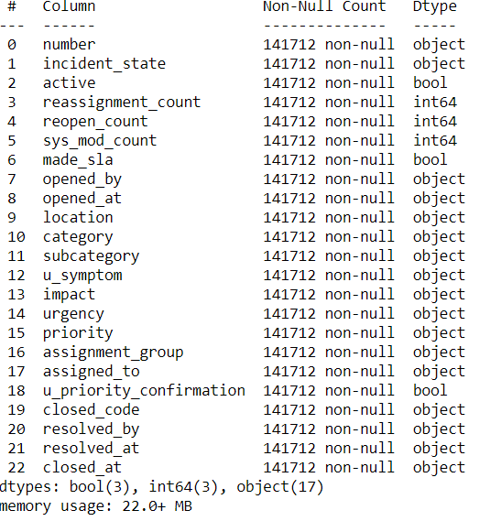
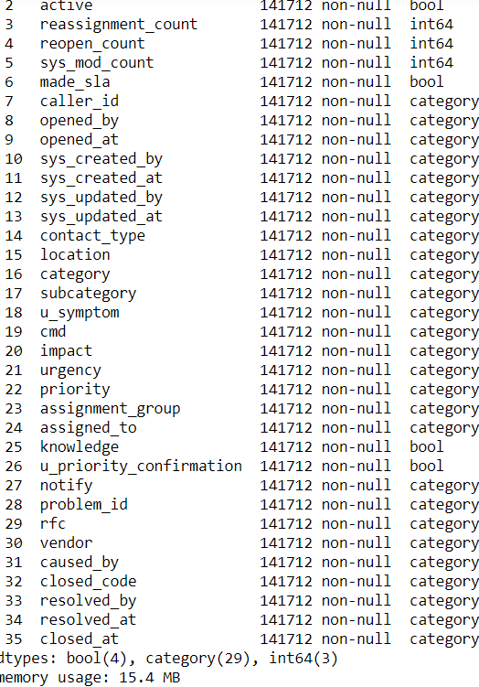
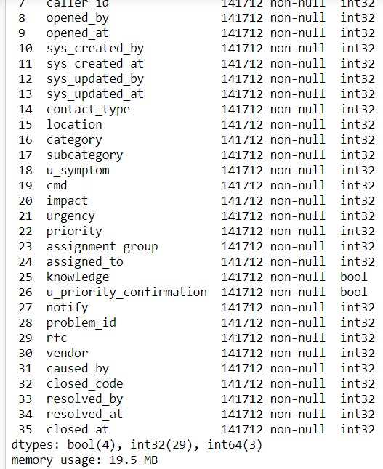
Conversion 3: Converting all the remaining data types to integer
Codes used for conversion:- As type & Label Enocoder
Before Conversion
As type category
Int64

Slide 12
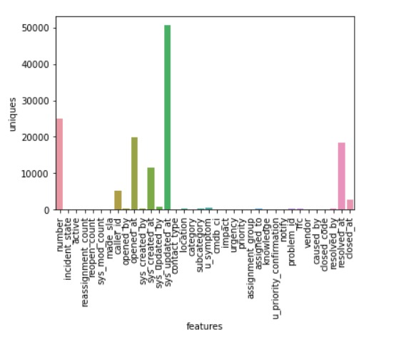
Unique values

Slide 13
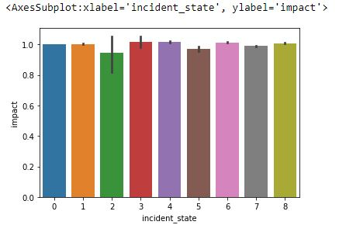
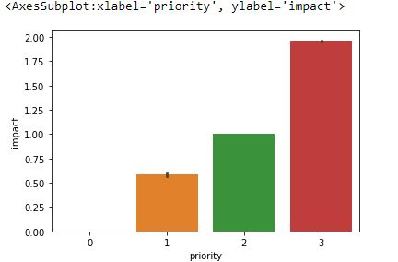
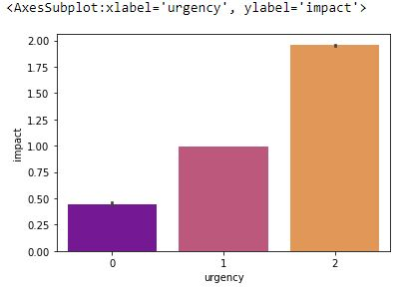
Visualization of the dataset using bar plots

Slide 14
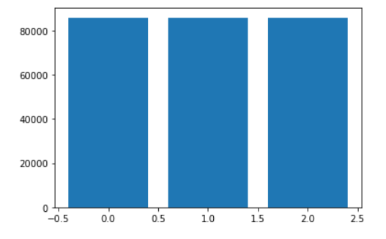
Balancing of the dataset
Impact :-before Balancing
Impact :-After Balancing

Slide 15
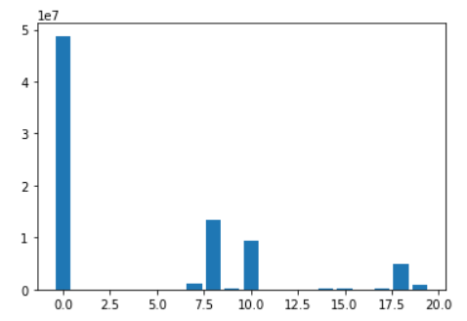
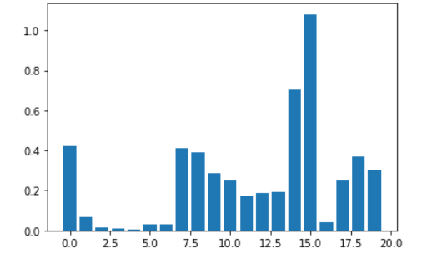
Feature engineering
Feature selection :
Chi square
Mutual info classifier
CHI-SQUARE
MUTUAL INFO CLASSIFIER

Slide 16
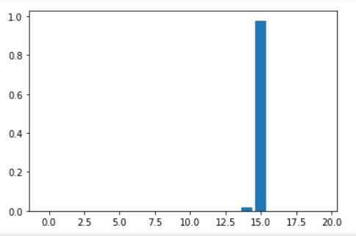
Feature extraction
Decision tree Classifier
Random forest classifier :- We got the Random Forest Score as 0.99
XGB classifier:- We got the XGB classifier Score as 1.00

Slide 17
Model Building

Slide 18
Template for Model results presentation
Model - SVM
Algorithms
Data set details
Algorithm details and configuration
Data Partition details
Accuracy:
Class wise accuracies
Recall
Precision
F1 score
Etc..

Slide 19
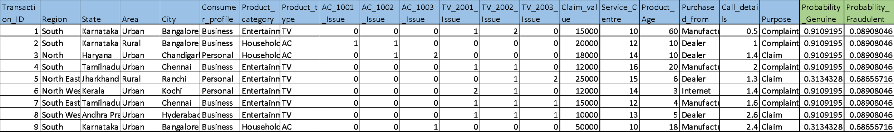
Model Predictions
Predicted probabilities for each transaction
Example
Transaction data fed to the model

Slide 20
Model Deployment using R shiny / Flask or any other method

Slide 21
Thank you

